Slide 1
Multimedia Systems Lecture – 8
By
Dr. Priyambada Subudhi
Assistant Professor
IIIT Sri City

Slide 2
Assessment Plan
Sl. No. | Mode of Assessment | % of Marks
1 | Mid Semester | 20
2 | End Semester | 30
3 | Scheduled Quiz | 20
4 | Surprised Quiz | 10
5 | Project | 20

Slide 3
8-bit color images
Many systems can utilize color information stored with only 8 bits of information (the so-called 256 colors) in producing a screen image.
Such image files use the concept of a lookup table to store color information.
Basically, the image stores not color, but instead just a set of bytes, each of which is actually an index into a table with 3-byte values that specify the color for a pixel with that lookup table index.

Slide 4
Color Lookup Tables
The idea used in 8-bit color images is to store only the index, or code value, for each pixel.
Then, if a pixel stores, say, the value 25, the meaning is to go to row 25 in a color lookup table (LUT).
For an 8-bit image, the image file can store in the file header information just what 8-bit values for R, G, and B correspond to each index.
The LUT is often called a palette.

Slide 5
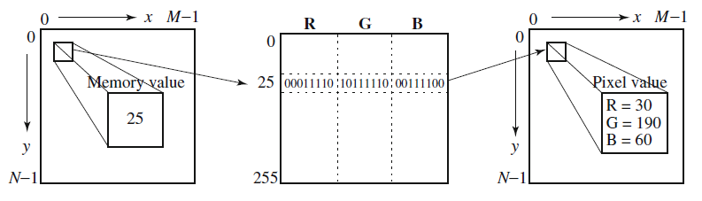
Color LUT for 8-bit color images

Slide 6
Color Histogram
It makes sense to carefully choose just which colors to represent best in the image.
if an image is mostly red sunset, it is reasonable to represent red with precision and store only a few greens.
Suppose all the colors in a 24-bit image were collected in a 256 × 256 × 256 set of cells, along with the count of how many pixels belong to each of these colors stored in that cell.
For example, if exactly 23 pixels have RGB values (45, 200, 91) then store the value 23 in a three-dimensional array, at the element indexed by the index values [45, 200, 91]
This data structure is called a color histogram.

Slide 7
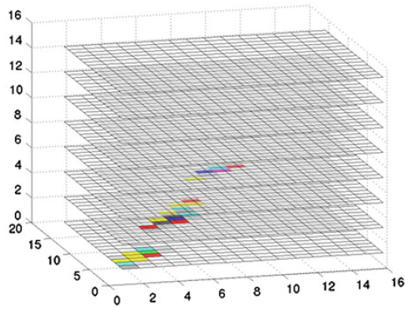
3D scatterplot of RGB colors in forestfire image
The histogram has 16 × 16 × 16 bins and shows the count in each bin in terms of intensity and pseudocolor.
We can see a few important clusters of color information, corresponding to the reds, yellows, greens, and so on, of the forestfire image.
Basically, large populations in 3D histogram bins can be subjected to a split-andmerge algorithm to determine the “best” 256 colors

Slide 8
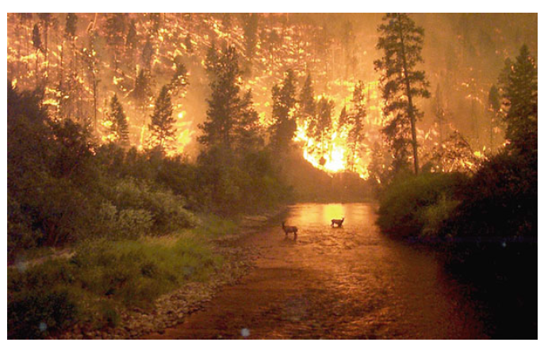
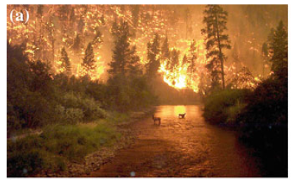
Example of an 8-bit color image
Note the great savings in space for 8-bit images over 24-bit ones: a 640 × 480 8-bit color image requires only 300kB of storage, compared to 921.6kB for a color image.
24-bit color image
8-bit color image

Slide 9
How to Transform to 8 bit RGB How to Select the Best 256 LUT RGB Entries Without Constructing a Color Histogram
Transform 3 bytes RGB to 8bit per pixel for 256 selective LUT table index by selecting RGB color separately.
Sort R byte in the original image to select 8 (3bits) most popular R intensities.
Those 8 most popular R byte codes to LUT.
Sort G byte to select 8 (3bits) most popular G intensities
Those 8 most popular G byte codes to LUT
Sort B byte to select 4 (2bits) most popular B intensities.
Those 4 B byte codes to LUT
All the combinations of 8R x 8G x 4B becomes 256 LUT RGB entries.
Transformed 3+3+2 bits per pixel is an index to transformed LUT.
Each pixel value in the original RGB is transformed to index value of the nearest RGB entries in LUT by comparing the original to RGB LUT entries.

Slide 10
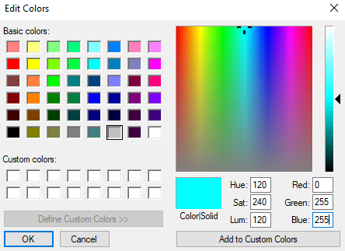
Color Picker
A color picker consists of an array of fairly large blocks of color (or a semicontinuous range of colors) such that a mouse click will select the color indicated.
In reality, a color picker displays the palette colors associated with index values from 0 to 255.
If the user selects the color block with index value 2, then the color meant is cyan, with RGB values (0, 255, 255).

Slide 11
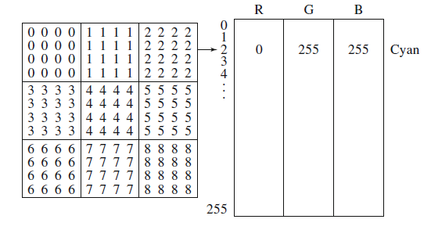
Color picker for 8-bit color: each block of the color picker corresponds to one row of the color LUT

